Slide 1
DATA MANIPULATION WITH PANDAS & DATA VISUALIZATION

Slide 2
Trainer Guidelines for Conducting Class
Solve questions live by creating new blank files (Excel, Python, Jupyter notebook, Dashboard) during the session, rather than sharing completed solutions.
Review teaching materials and solutions beforehand, and prepare additional examples to reinforce learning.
Ensure online students can hear you and see the screen clearly at all times.
Test your computer and necessary software before class begins.
Check with online students every 15-20 minutes to see if they understand the material and have any questions.

Slide 3

Day 4: Agenda
Data Exploration
Creating & Saving Basic Plots Using Matplotlib
Creating Statistical Plots Using Seaborn
Exploring Relationships In Data: Pair Plot & Heat Map
Practical Exercise
Git & GitHub

Slide 4
Data Exploration
Data exploration is a critical first step in data analysis because it:
Helps understand your data's structure and variables.
Detects and addresses data quality issues like missing values and outliers.
Validates data types and formats.
Guides data preprocessing decisions.
Reveals patterns and relationships.
Facilitates effective visualization.
Integrates domain knowledge.

Slide 5
Baic Data Exploration
Load the Data:
import pandas as pd
df = pd.read_csv('your_dataset.csv')
Check Dimensions:
Df.shape
View the Data:
df.head()
Summary Statistics:
df.describe()
Data Types:
Df.dtypes
Missing Values:
df.isnull().sum()
Unique Values (for categorical columns):
df['categorical_column'].value_counts()
Data Distribution (histogram):
import matplotlib.pyplot as plt
df['numeric_column'].hist()
plt.show()
Correlation: df.corr()
Outliers (box plot):
df.boxplot(column='numeric_column')
Visualization (scatter plot):
plt.scatter(df['x'], df['y'])
plt.xlabel('X')
plt.ylabel('Y')
plt.show()

Slide 6
Handling Missing Values
Deletion:
Remove rows with missing values:
df.dropna(inplace=True)
Remove columns with many missing values:
df.drop('column_name', axis=1, inplace=True)
Imputation:
Fill missing values with the mean:
df['numeric_column'].fillna(df['numeric_column'].mean(), inplace=True)
Forward or backward fill:
df.ffill() # Forward fill
df.bfill() # Backward fill
Indicator Variables:
df['column_name_missing'] = df['column_name'].isnull().astype(int)

Slide 7

Matplotlib Library
Python Visualization Library: Matplotlib is a Python library.
Wide Usage: It's used for creating 2D and 3D visualizations.
Ease of Use: Provides a user-friendly interface.
Flexibility: Offers extensive customization options.
Various Plot Types: Supports diverse plot types.
Integration: Easily integrates with other Python libraries.
Community: Active user community with extensive resources.
Publication Quality: Suitable for creating high-quality plots
To import:
Import matplotlib.pyplot as plt

Slide 8
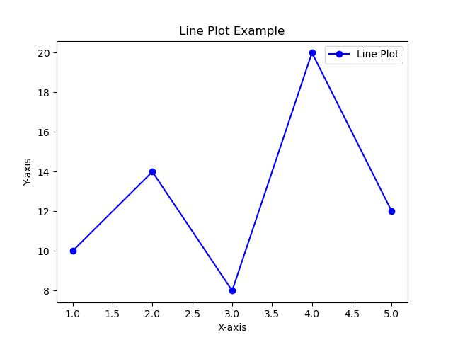
Creating Basic Plot
Line Plot:
import matplotlib.pyplot as plt
# Sample data
x = [1, 2, 3, 4, 5]
y = [10, 14, 8, 20, 12]
# Create a line plot
plt.plot(x, y, marker='o', linestyle='-', color='b', label='Line Plot')
# Adding labels and a legend
plt.xlabel('X-axis')
plt.ylabel('Y-axis')
plt.title('Line Plot Example')
plt.legend()
# Show the plot
plt.show()

Slide 9
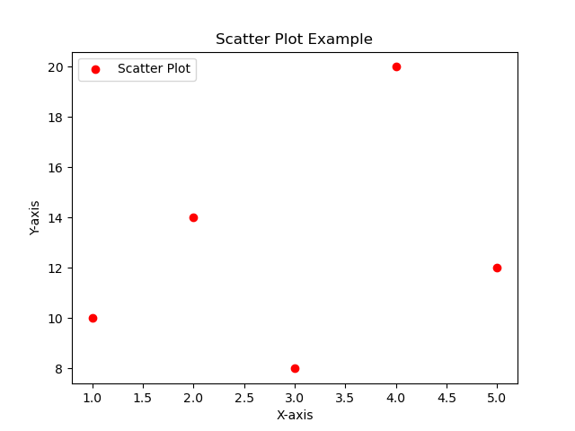
Creating Basic Plot
Scatter Plot:
import matplotlib.pyplot as plt
# Sample data
x = [1, 2, 3, 4, 5]
y = [10, 14, 8, 20, 12]
# Create a scatter plot
plt.scatter(x, y, marker='o', color='r', label='Scatter Plot')
# Adding labels and a legend
plt.xlabel('X-axis')
plt.ylabel('Y-axis')
plt.title('Scatter Plot Example')
plt.legend()
# Show the plot
plt.show()

Slide 10
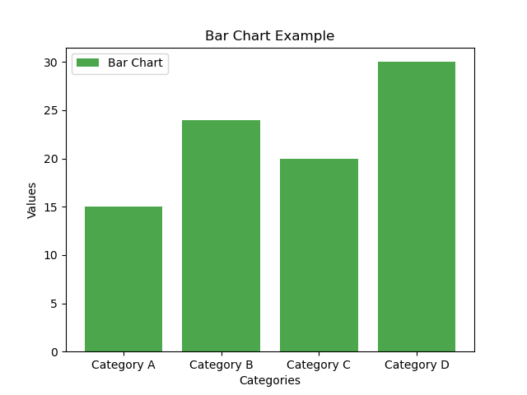
Creating Basic Plot
Bar Chart:
import matplotlib.pyplot as plt
# Sample data
categories = ['Category A', 'Category B', 'Category C', 'Category D']
values = [15, 24, 20, 30]
# Create a bar chart
plt.bar(categories, values, color='g', alpha=0.7, label='Bar Chart')
# Adding labels and a legend
plt.xlabel('Categories')
plt.ylabel('Values')
plt.title('Bar Chart Example')
plt.legend()
# Show the plot
plt.show()

Slide 11
Customising Plots
xlabel() and ylabel(): Add labels to the x-axis and y-axis. plt.xlabel('X-axis Label') plt.ylabel('Y-axis Label') title(): Set a title for your plot. plt.title('Plot Title') | linewidth: Adjust the line width. plt.plot(x, y, linewidth=2) markersize: Change the size of markers. plt.scatter(x, y, marker='o', markersize=8)
legend(): Display a legend to distinguish multiple data series.plt.plot(x1, y1, label='Series 1') plt.plot(x2, y2, label='Series 2') plt.legend() | xlim() and ylim(): Set specific limits for the x-axis and y-axis. plt.xlim(0, 10) plt.ylim(0, 30) grid(): Add grid lines to the plot. plt.grid(True)
color: Change the line or marker color. plt.plot(x, y, color='blue') linestyle: Modify the line style (e.g., '-', '--', '-.', ':'). plt.plot(x, y, linestyle='--') marker: Specify markers (e.g., 'o', 's', '^') for data points. plt.scatter(x, y, marker='o') | text(): Add text annotations to the plot. plt.text(2, 25, 'Annotation Text', fontsize=12, color='red') color-based visualizations. plt.imshow(data, cmap='viridis') figure(): Adjust the figure size. plt.figure(figsize=(8, 6))

Slide 12
Saving Plots
Import Matplotlib.
Create your plot using plt.plot(), plt.scatter(), or any other plot function.
Customize the plot as needed (e.g., add labels and a title).
Use plt.savefig() to save the plot as an image file. You provide the file name with the desired file extension (e.g., 'my_plot.png', 'my_plot.pdf').
# Save the plot as an image file (e.g., PNG)
plt.savefig('my_plot.png')
# Save as PDF
plt.savefig('my_plot.pdf')

Slide 13

Introducing Seaborn
Seaborn is a data visualization library.
Built on top of Matplotlib.
Designed for creating beautiful and informative statistical plots.

Slide 14
Benefits of Seaborn
Enhanced Aesthetics: Seaborn provides attractive default styles.
Statistical Insights: Offers functions for statistical visualization.
Efficiency: Streamlined syntax for complex plots.
Integration: Works seamlessly with Pandas DataFrames.
Advanced Features: Multi-plot grids and customization options.
Data Professional's Choice: Popular among data experts.
Matplotlib Extension: Extends Matplotlib's capabilities

Slide 15
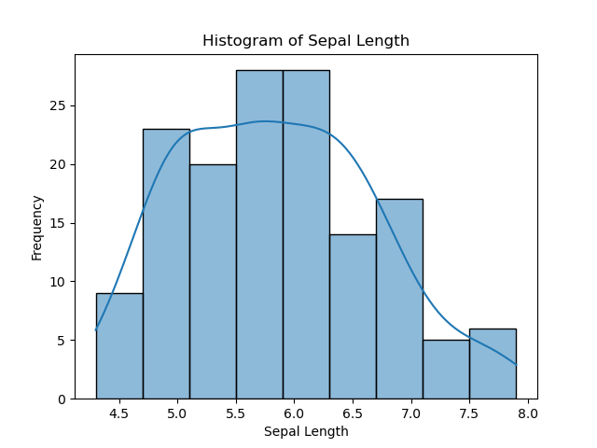
Creating Statistical Plots
1. Histogram:
import seaborn as sns
import matplotlib.pyplot as plt
# Sample data
data = sns.load_dataset("iris")
# Create a histogram
sns.histplot(data=data, x="sepal_length", kde=True)
# Adding labels and a title
plt.xlabel("Sepal Length")
plt.ylabel("Frequency")
plt.title("Histogram of Sepal Length")
# Show the plot
plt.show()

Slide 16
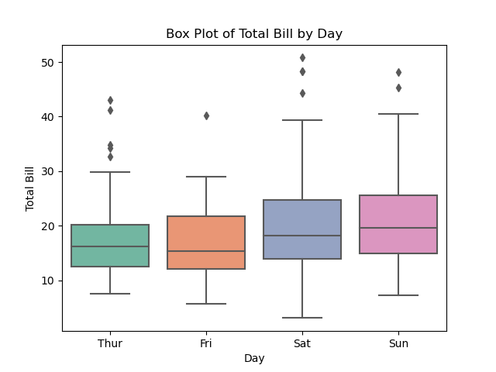
Creating Statistical Plots
1. Box Plot:
import seaborn as sns
import matplotlib.pyplot as plt
# Sample data
data = sns.load_dataset("tips")
# Create a box plot
sns.boxplot(data=data, x="day", y="total_bill", palette="Set2")
# Adding labels and a title
plt.xlabel("Day")
plt.ylabel("Total Bill")
plt.title("Box Plot of Total Bill by Day")
# Show the plot
plt.show()

Slide 17
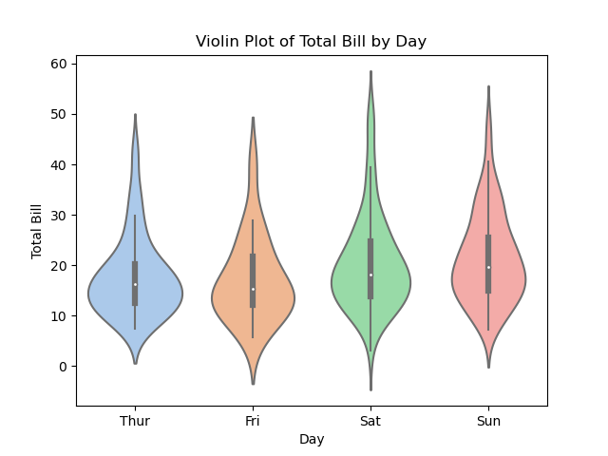
Creating Statistical Plots
2. Violin Plot:
import seaborn as sns
import matplotlib.pyplot as plt
# Sample data
data = sns.load_dataset("tips")
# Create a violin plot
sns.violinplot(data=data, x="day", y="total_bill", palette="pastel")
# Adding labels and a title
plt.xlabel("Day")
plt.ylabel("Total Bill")
plt.title("Violin Plot of Total Bill by Day")
# Show the plot
plt.show()

Slide 18
Exploring Relationships in Data
1. Pair Plot:
Pair Plot is a visualization tool that helps explore relationships between multiple variables in a dataset.
It displays scatter plots for all possible pairs of numeric variables and histograms for the diagonal (self-comparisons).
Each scatter plot reveals how two variables interact, providing insights into correlations, trends, and potential patterns.
Pair plots are especially useful in exploratory data analysis (EDA) to identify interesting relationships and guide further analysis.

Slide 19
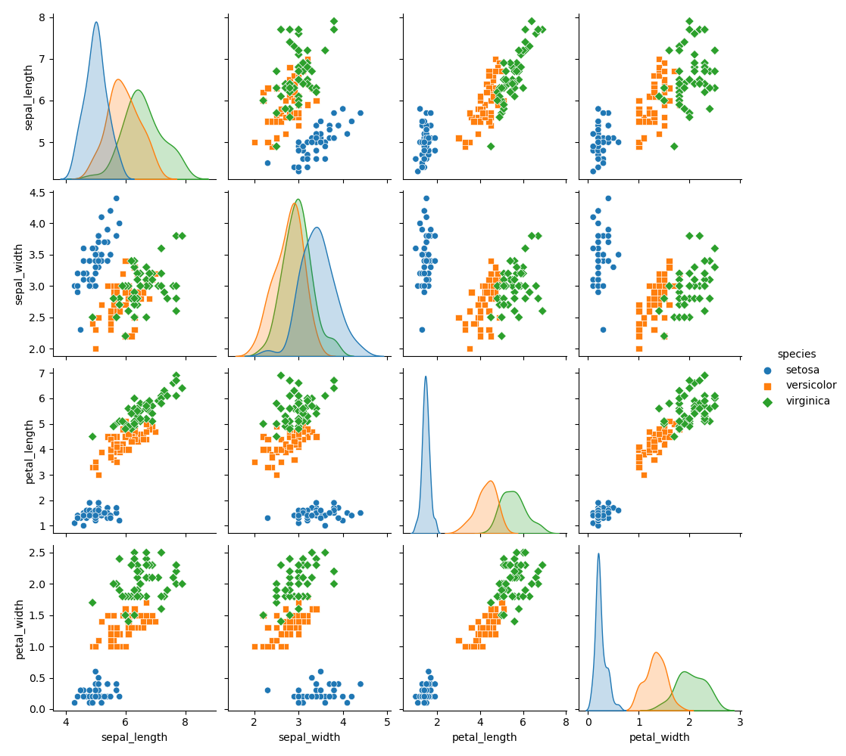
Exploring Relationships in Data
Pair Plot:
import seaborn as sns
import matplotlib.pyplot as plt
# Load a sample dataset
data = sns.load_dataset("iris")
# Create a pair plot
sns.pairplot(data, hue="species", markers=["o", "s", "D"])
# Show the plot
plt.show()

Slide 20
Exploring Relationships in Data
2. Heat Map:
A Heat Map is a graphical representation of a correlation matrix.
It visualizes relationships between variables by assigning colors to represent the strength and direction of correlations.
Positive correlations are often shown in warm colors (e.g., red), while negative correlations are in cool colors (e.g., blue).
Heat maps are valuable for identifying which variables are strongly related and which are not, aiding in feature selection and understanding dependencies in the data.
Commonly used in data preprocessing, feature engineering, and identifying multicollinearity in regression analysis.

Slide 21
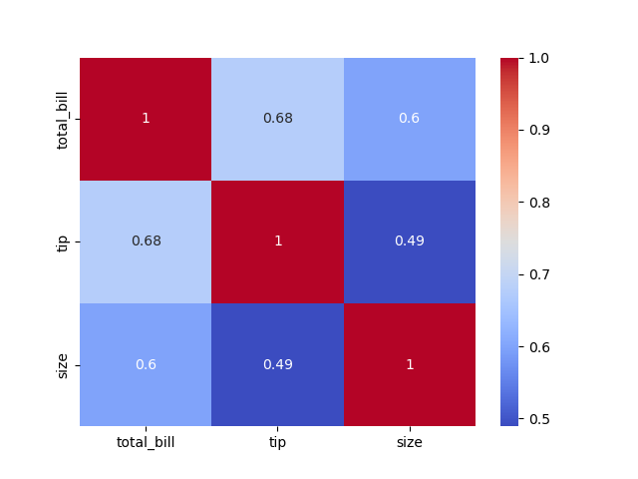
Exploring Relationships in Data
Heat Map:
import seaborn as sns
import matplotlib.pyplot as plt
# Load the "tips" dataset
data = sns.load_dataset("tips")
# Select relevant numeric columns
numeric_data = data[['total_bill', 'tip', 'size']]
# Calculate the correlation matrix
correlation_matrix = numeric_data.corr()
# Create a heat map
sns.heatmap(correlation_matrix, annot=True, cmap="coolwarm")
# Show the plot
plt.show()

Slide 22
Practical Exercise
Notes:
Note: Use Jupyeter File for this Exercise -

Slide 23


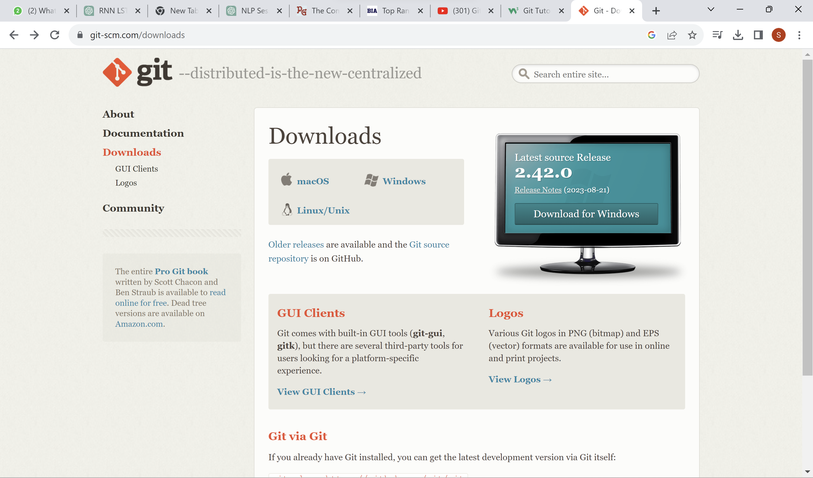
Git & GitHub
Git is a version control system.
Git helps you keep track of code changes.
Git is used to collaborate on code.
Git Download & Install
https://git-scm.com/downloads

Slide 24
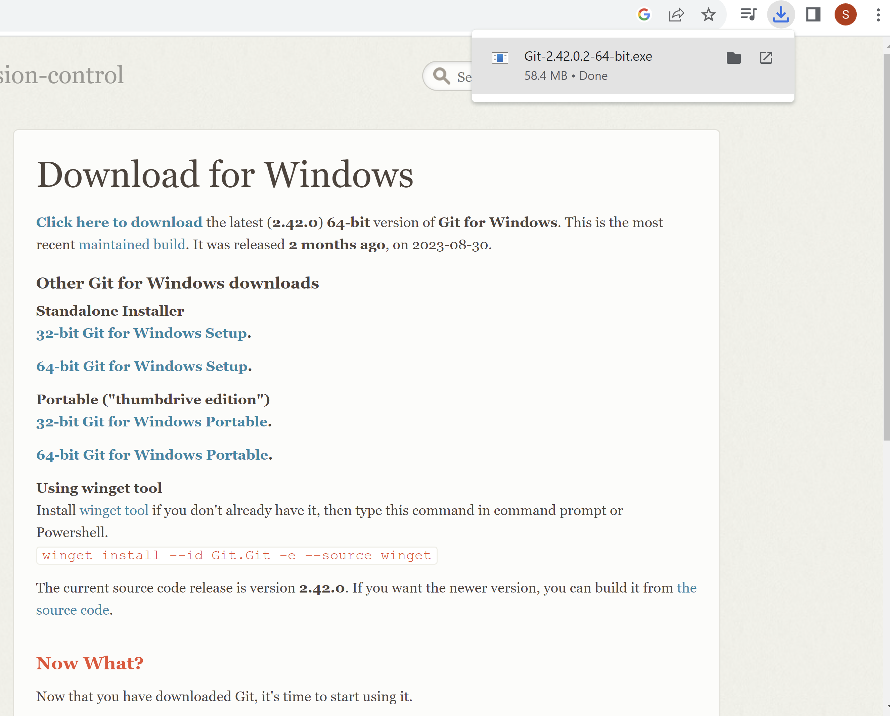
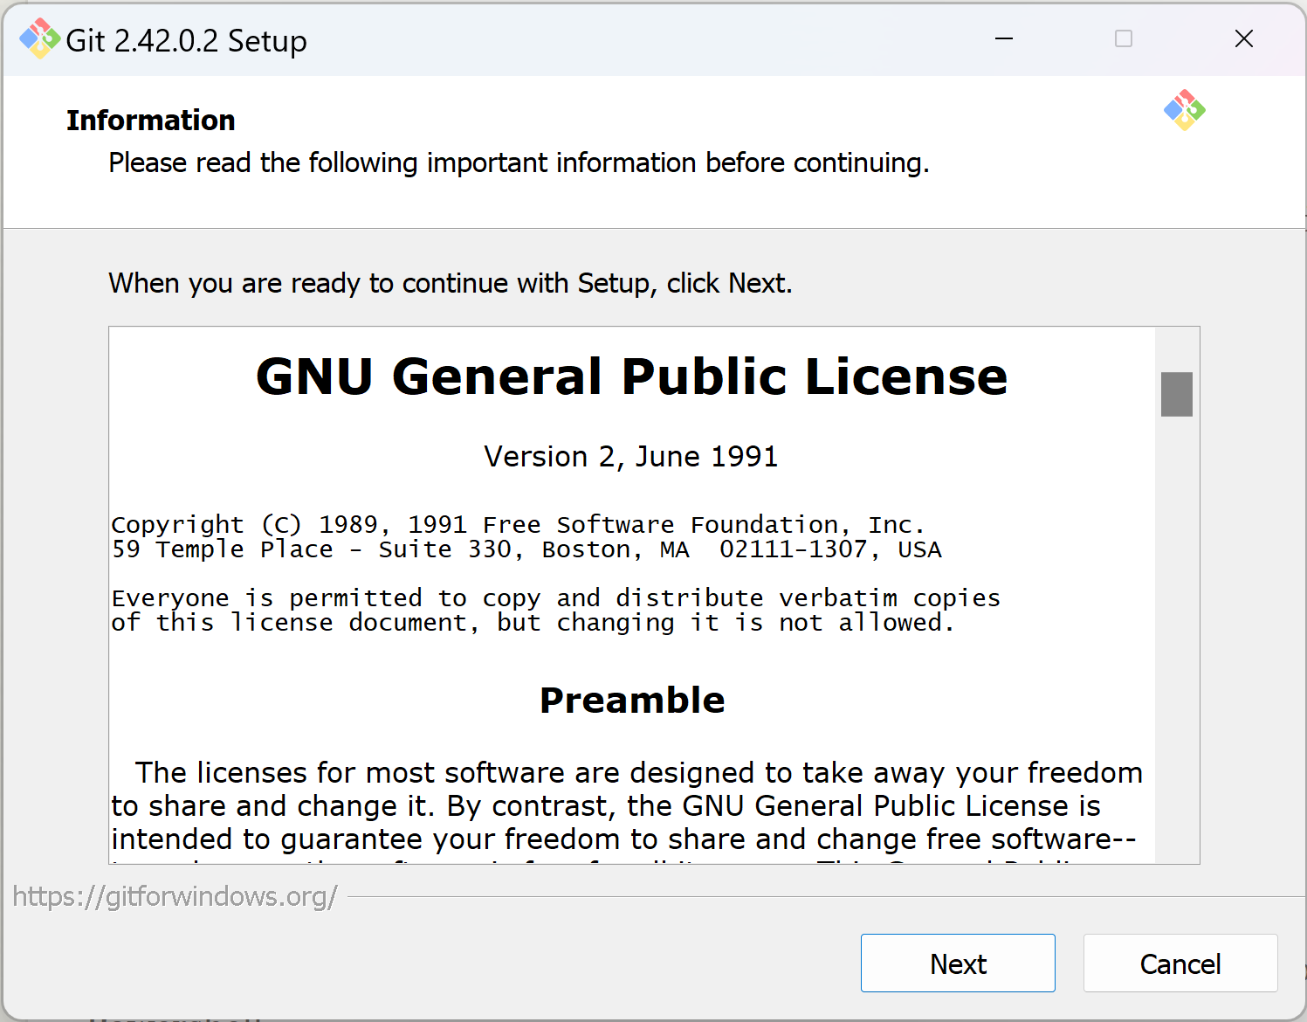
Git

Slide 25
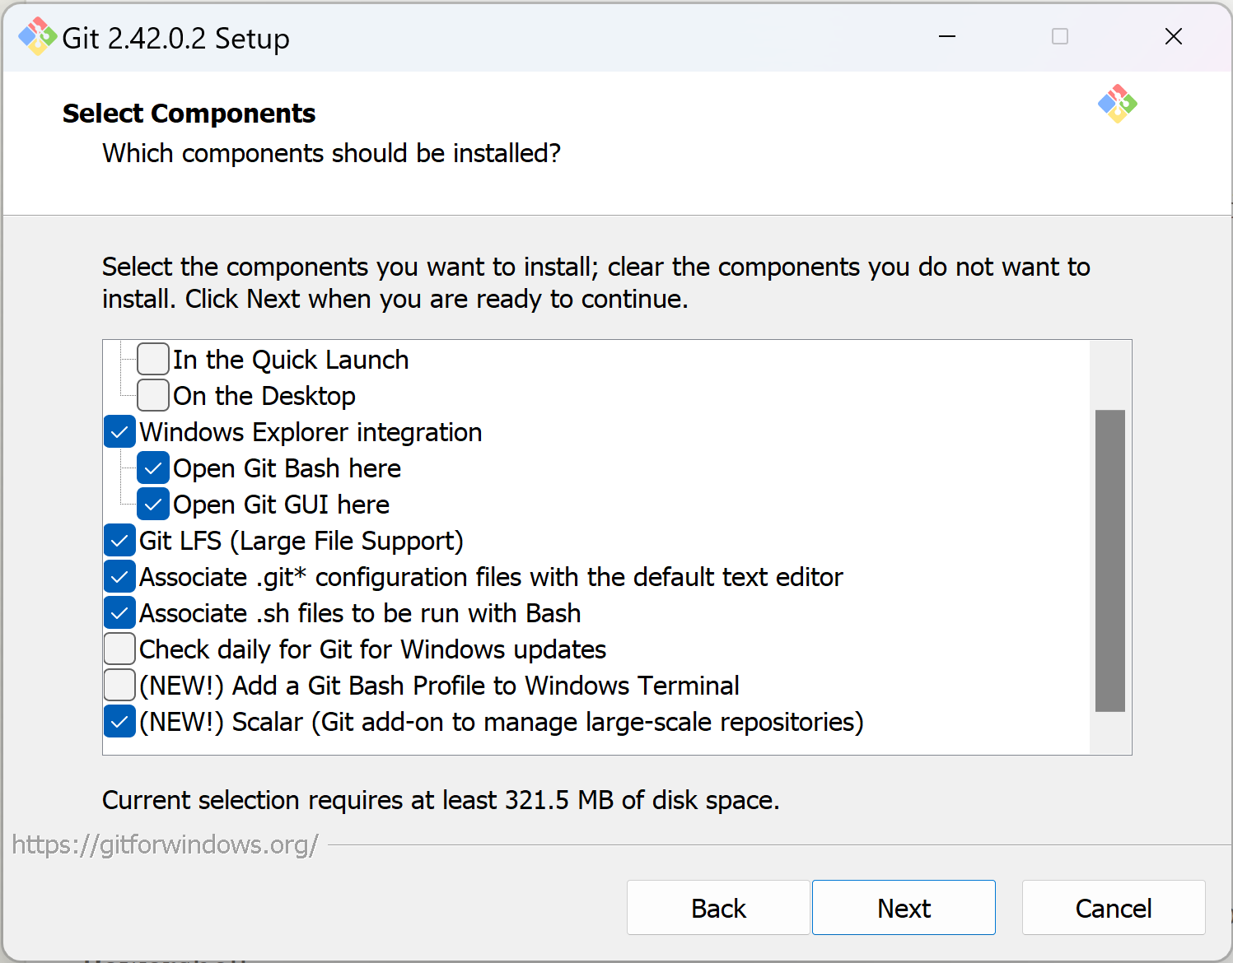
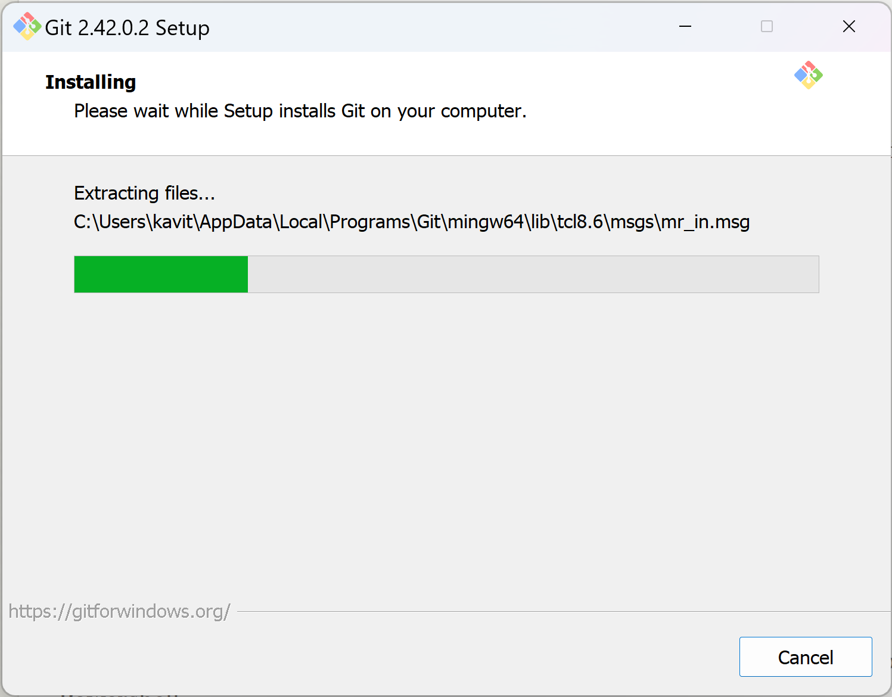
Git

Slide 26
Git

Slide 27
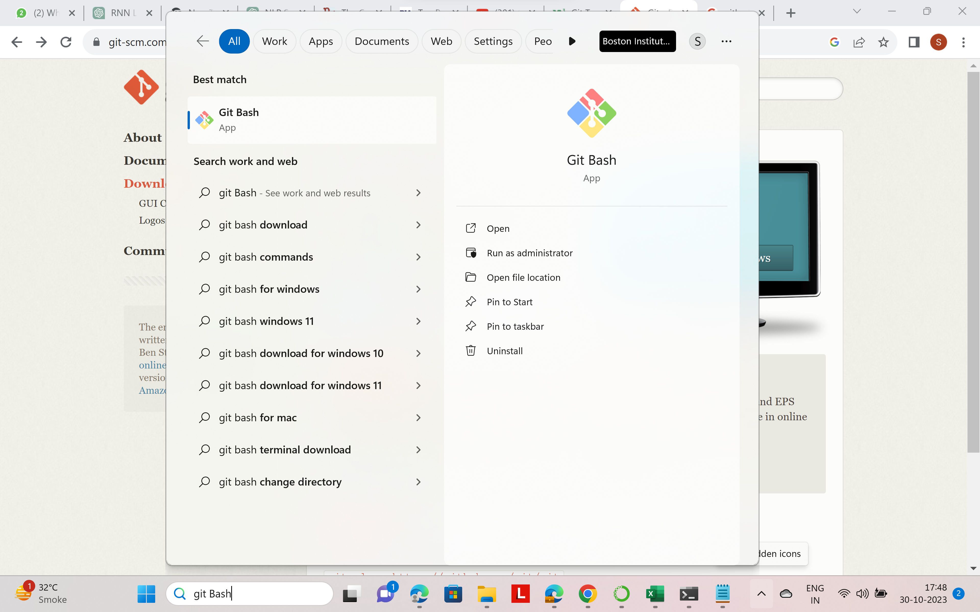
Git

Slide 28
Git Introduction
What is Git?
Version Control: Git is a version control system.
Created by Linus Torvalds: Developed by Linus Torvalds in 2005, maintained by Junio Hamano.
Usage: It's used for tracking code changes, identifying contributors, and facilitating coding collaboration.
What Git Does:
Manages Repositories: Git manages projects using repositories.
Cloning: You can clone a project for local work.
Staging and Committing: Control and track changes through staging and committing.
Branch and Merge: Create branches for different project versions.
Pull and Push: Pull the latest version and push local updates.

Slide 29
Git Introduction
How Git Works:
Initialization: Initialize Git in a folder to create a repository.
Tracking Changes: Git monitors changes in files.
Staging: Select files to stage.
Committing: Staged files are committed, creating a permanent snapshot.
Commit History: Git keeps a full history of every commit.
Reverting: You can revert to any previous commit.
Efficiency: Git tracks changes, not separate copies of files in every commit.

Slide 30
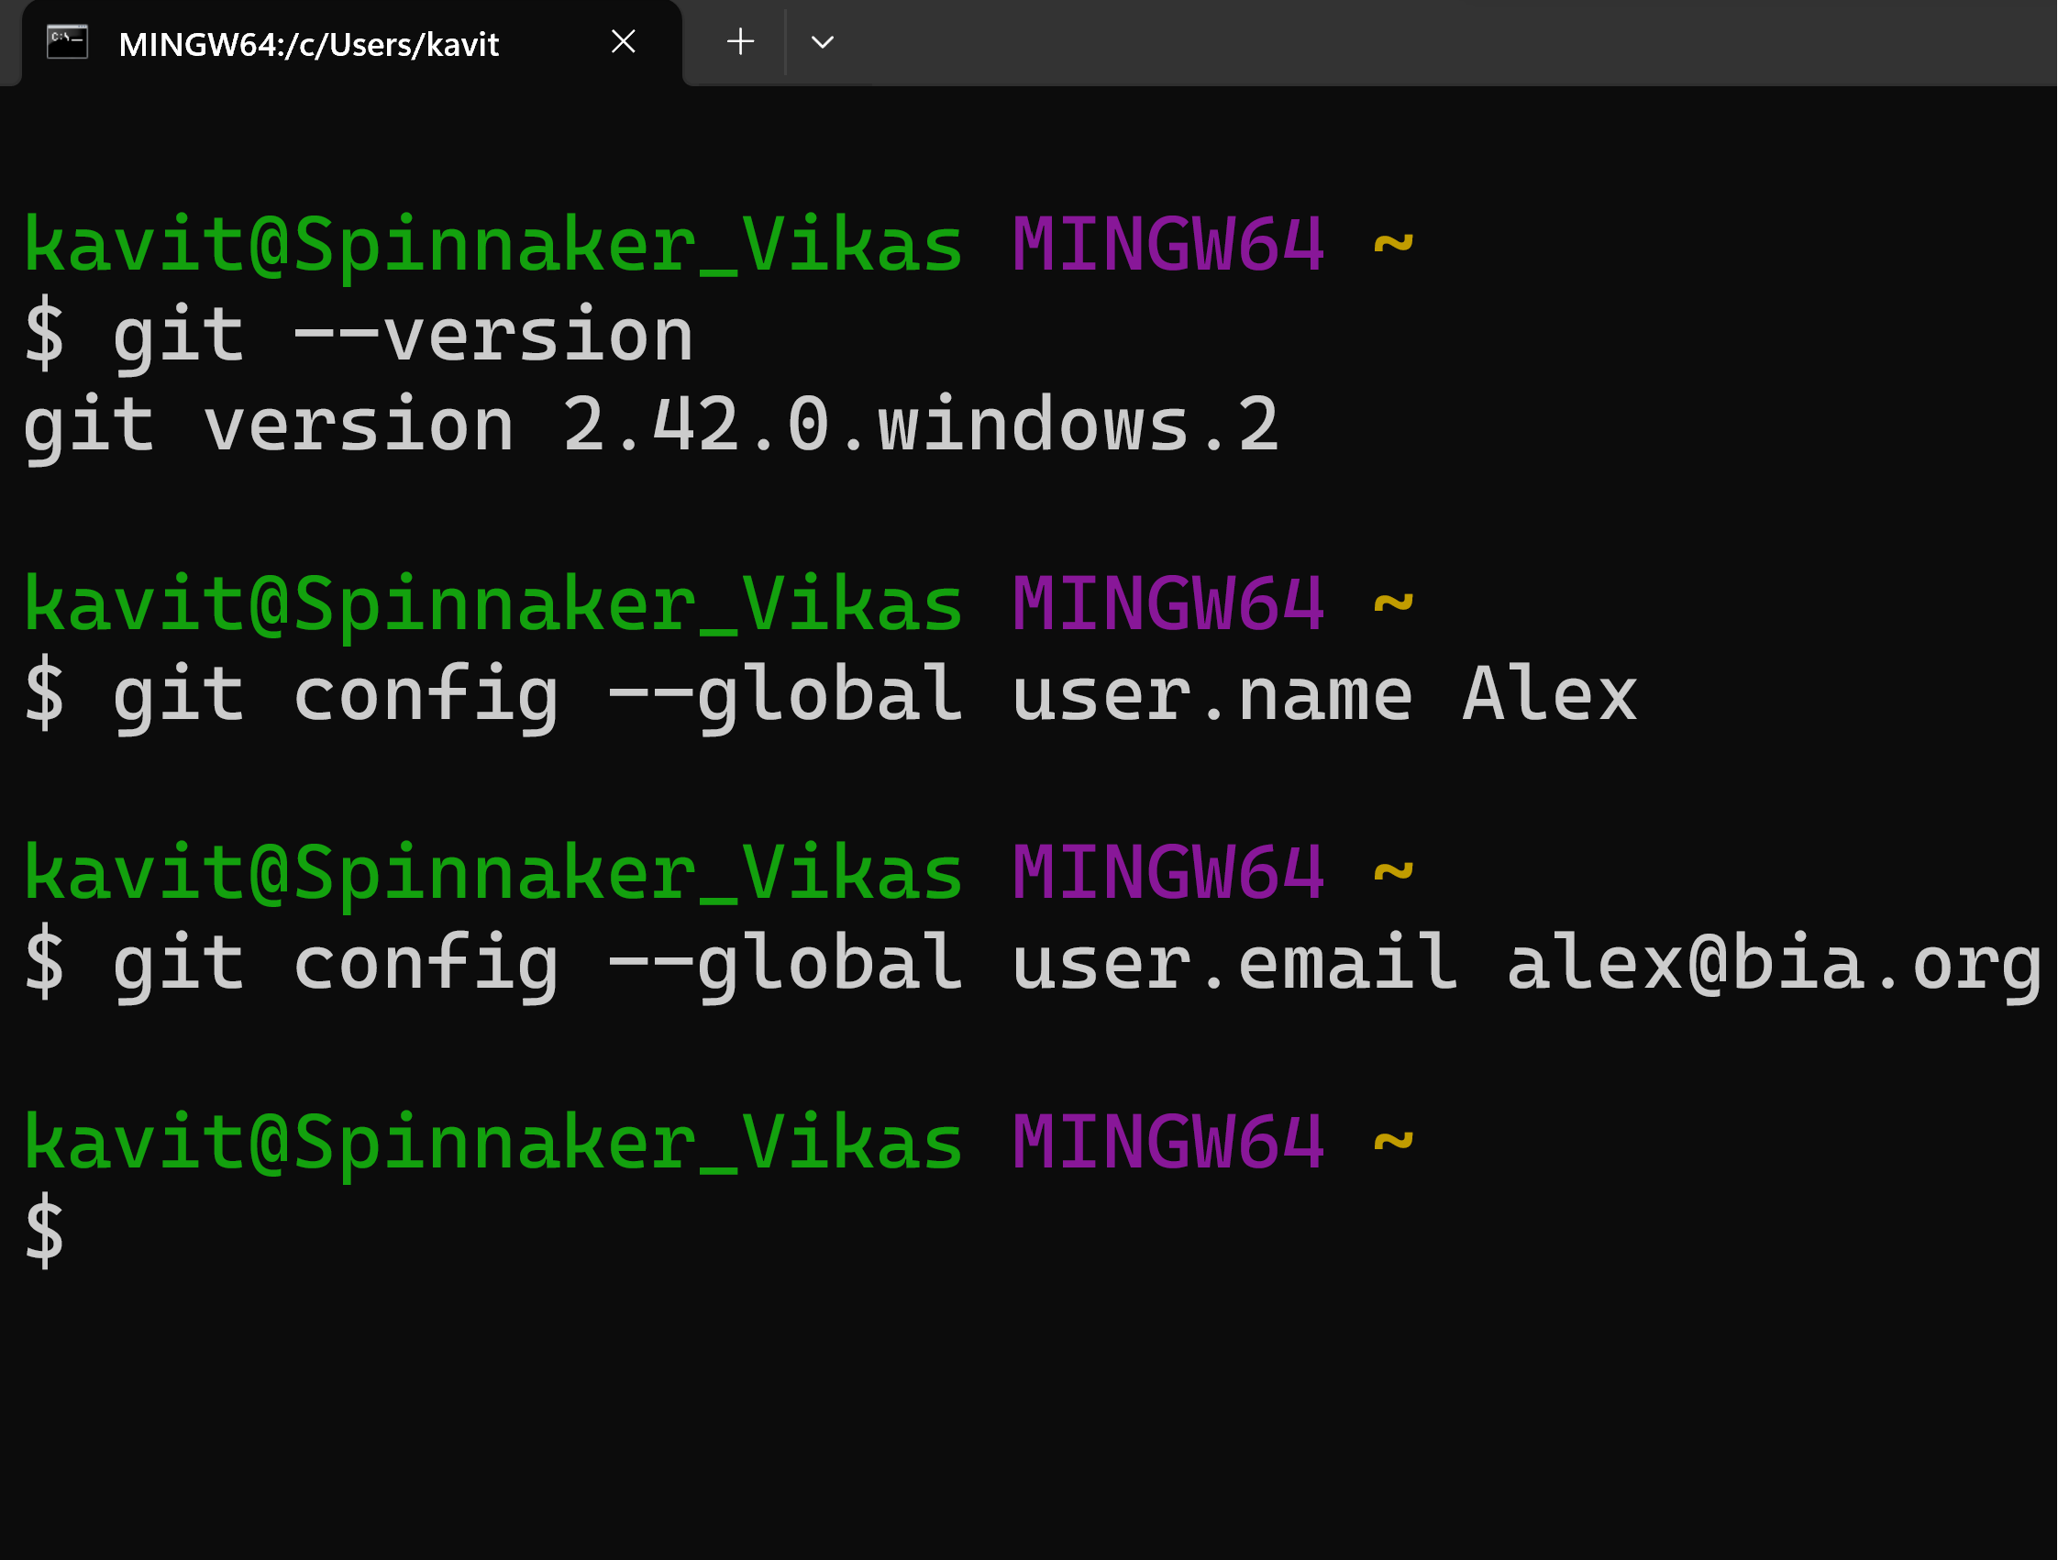
Git commands
To check the installed git version
2. Username for every repository on your computer
3. E-mail for every repository on your computer

Slide 31
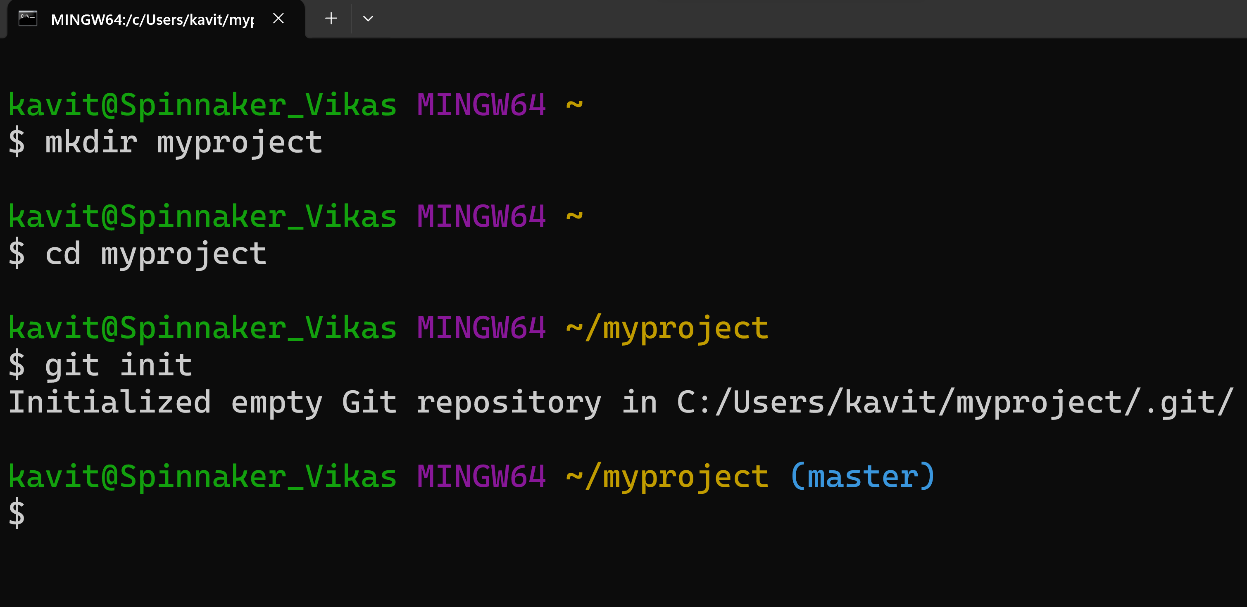
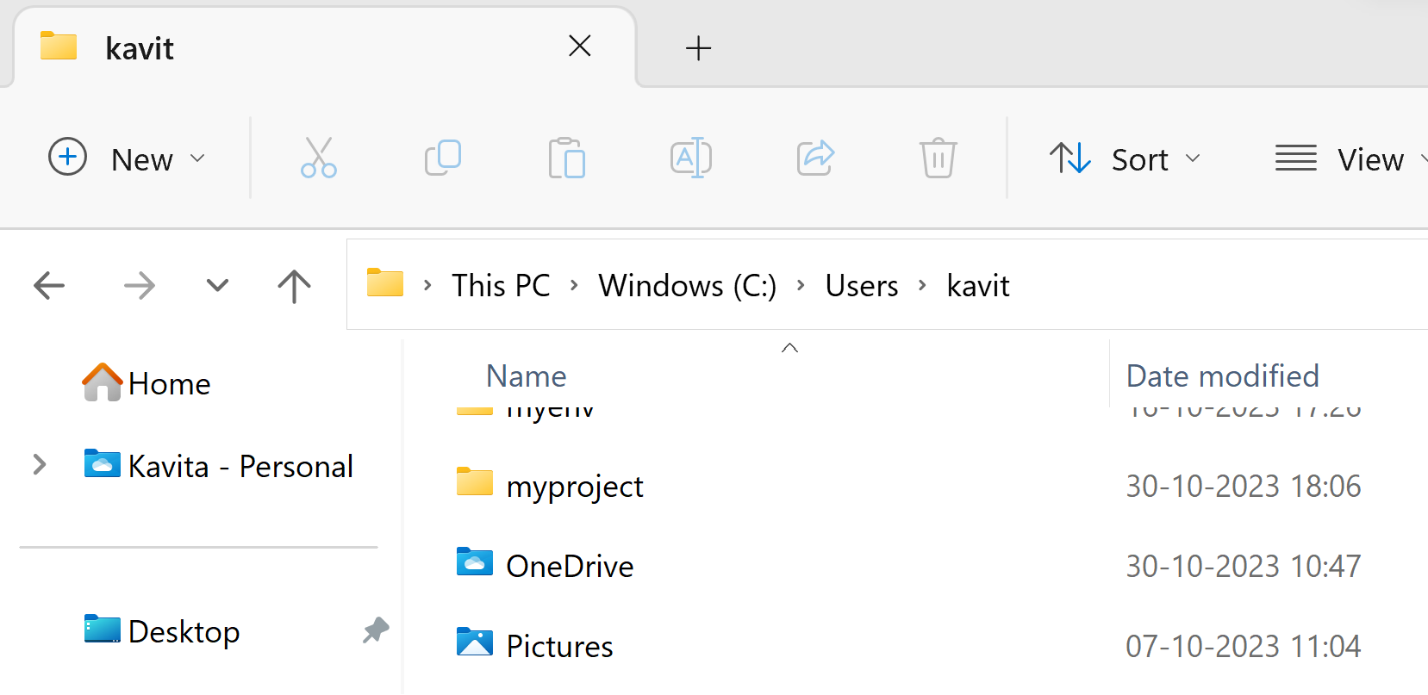
Git commands
Creating Git Folder
2. changes the current working directory
3. Initialize Git

Slide 32

Git commands
Let's add/create files in folder "myproject"

Slide 33
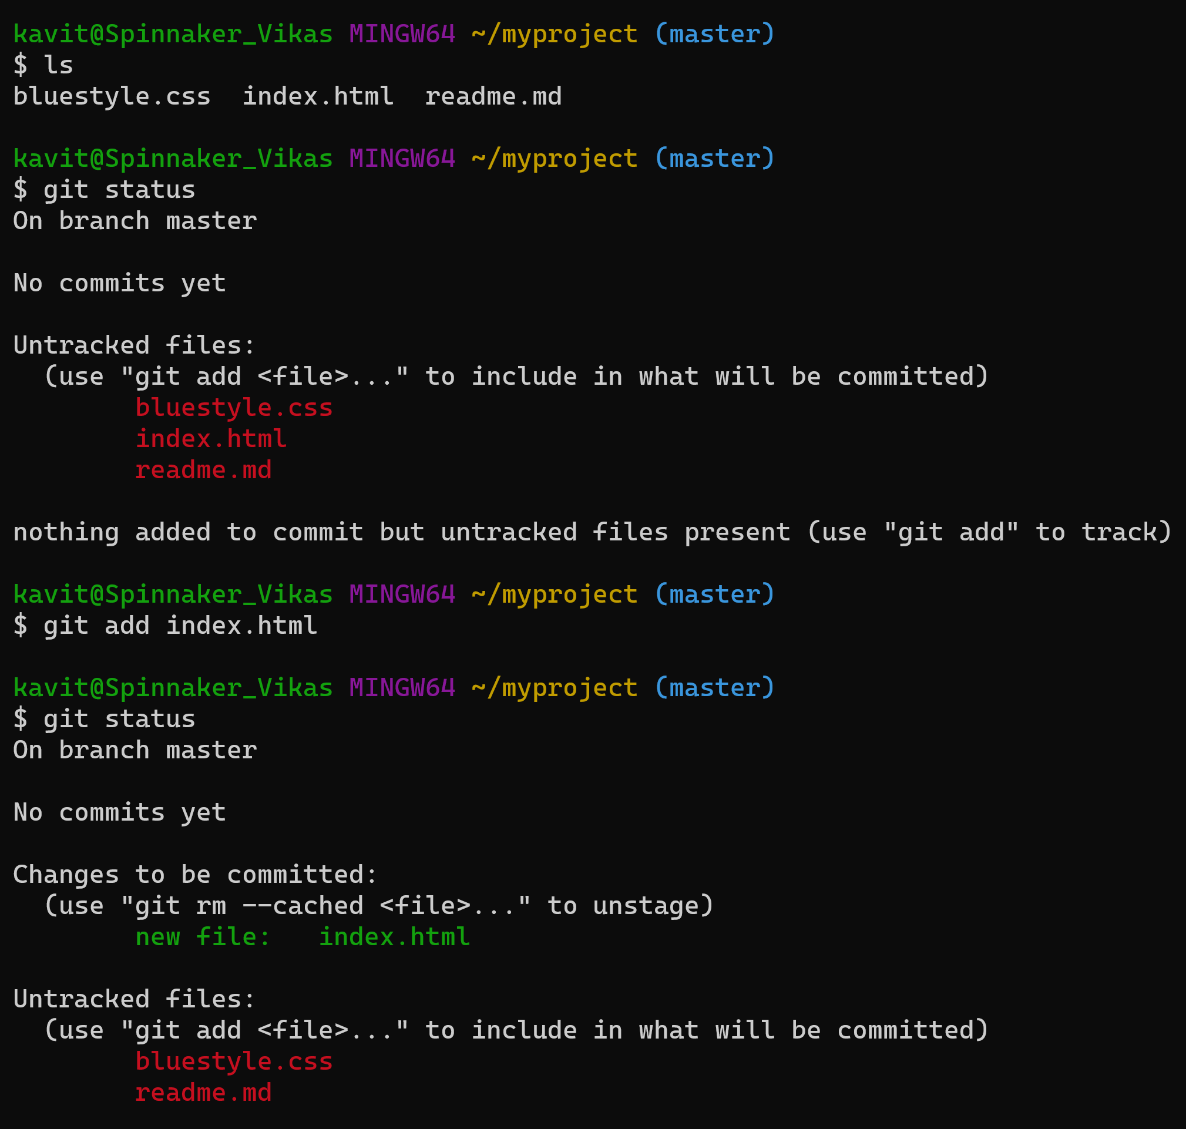
Git commands
ls will list the files in the directory
git status to see if files are a part of our repo
Index.html file to be staged/added in repo.
Check the status again

Slide 34
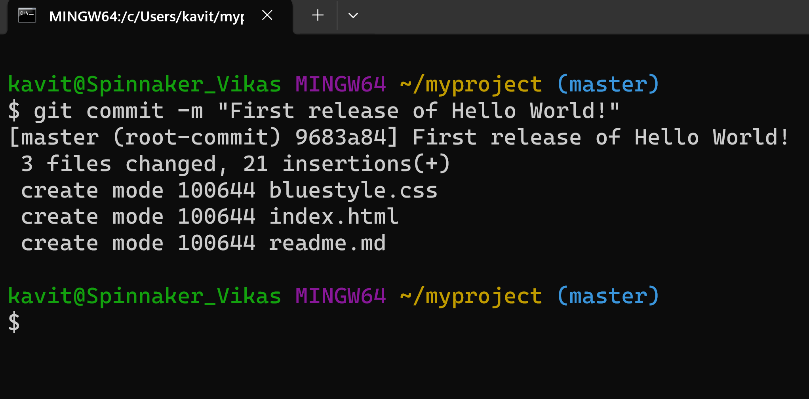
Git commands
Git Commit:
To move from stage to commit for our repo.
Include message while commit.

Slide 35
Git commands
Let's make these changes in index.html file (open with notepad)
<!DOCTYPE html> <html> <head> <title>Hello World!</title> <link rel="stylesheet" href="bluestyle.css"> </head> <body> <h1>Hello world!</h1> <p>This is the first file in my new Git Repo.</p> <p>A new line in our file!</p> </body> </html>

Slide 36
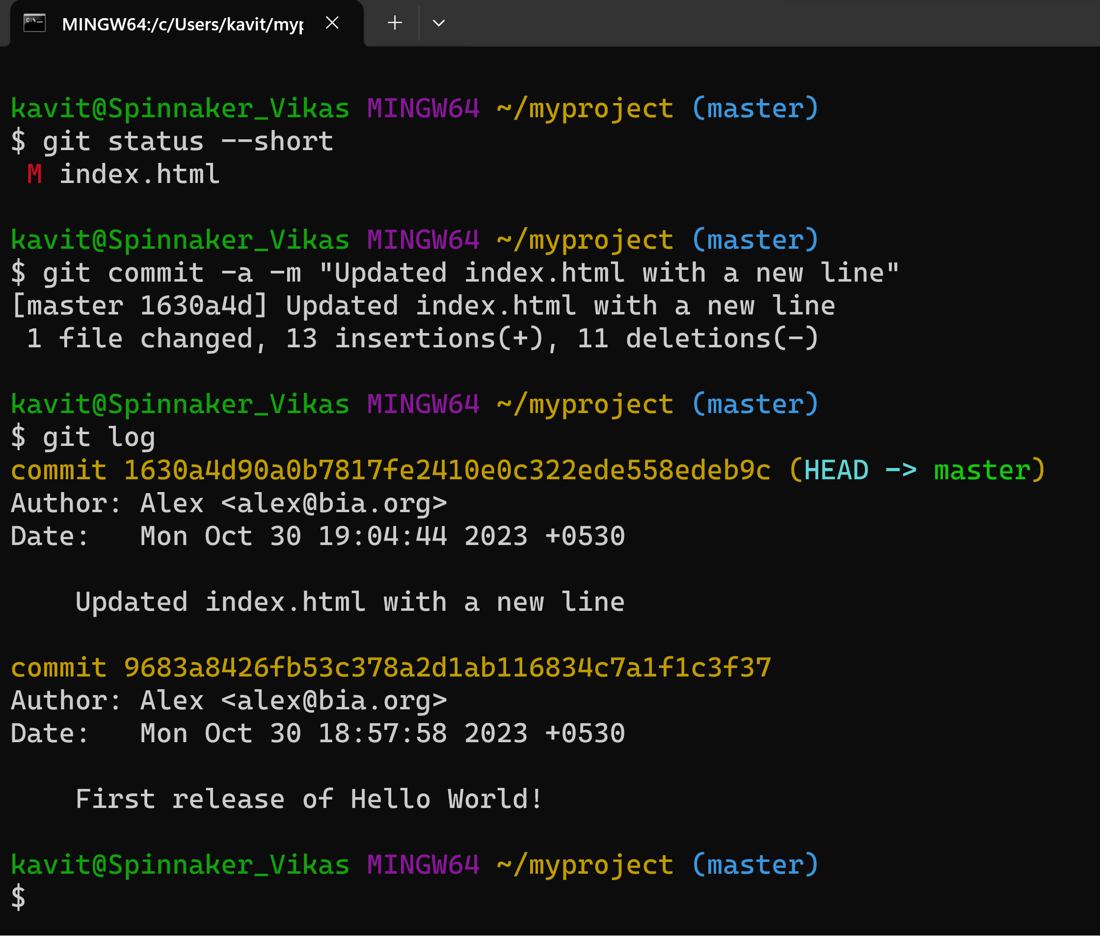
Git commands
--short option to see the changes in
Short status flags are:
?? - Untracked files
A - Files added to stage
M - Modified files
D - Deleted files
log command to view the history of commits for a repository

Slide 37
Git commands
Git Help
$ git command -help - See all the available options for the specific command
$ git help --all - See all possible commands
Git -help See Options for a Specific Command
$ git commit –help
Git help --all See All Possible Commands
$ git help --all

Slide 38
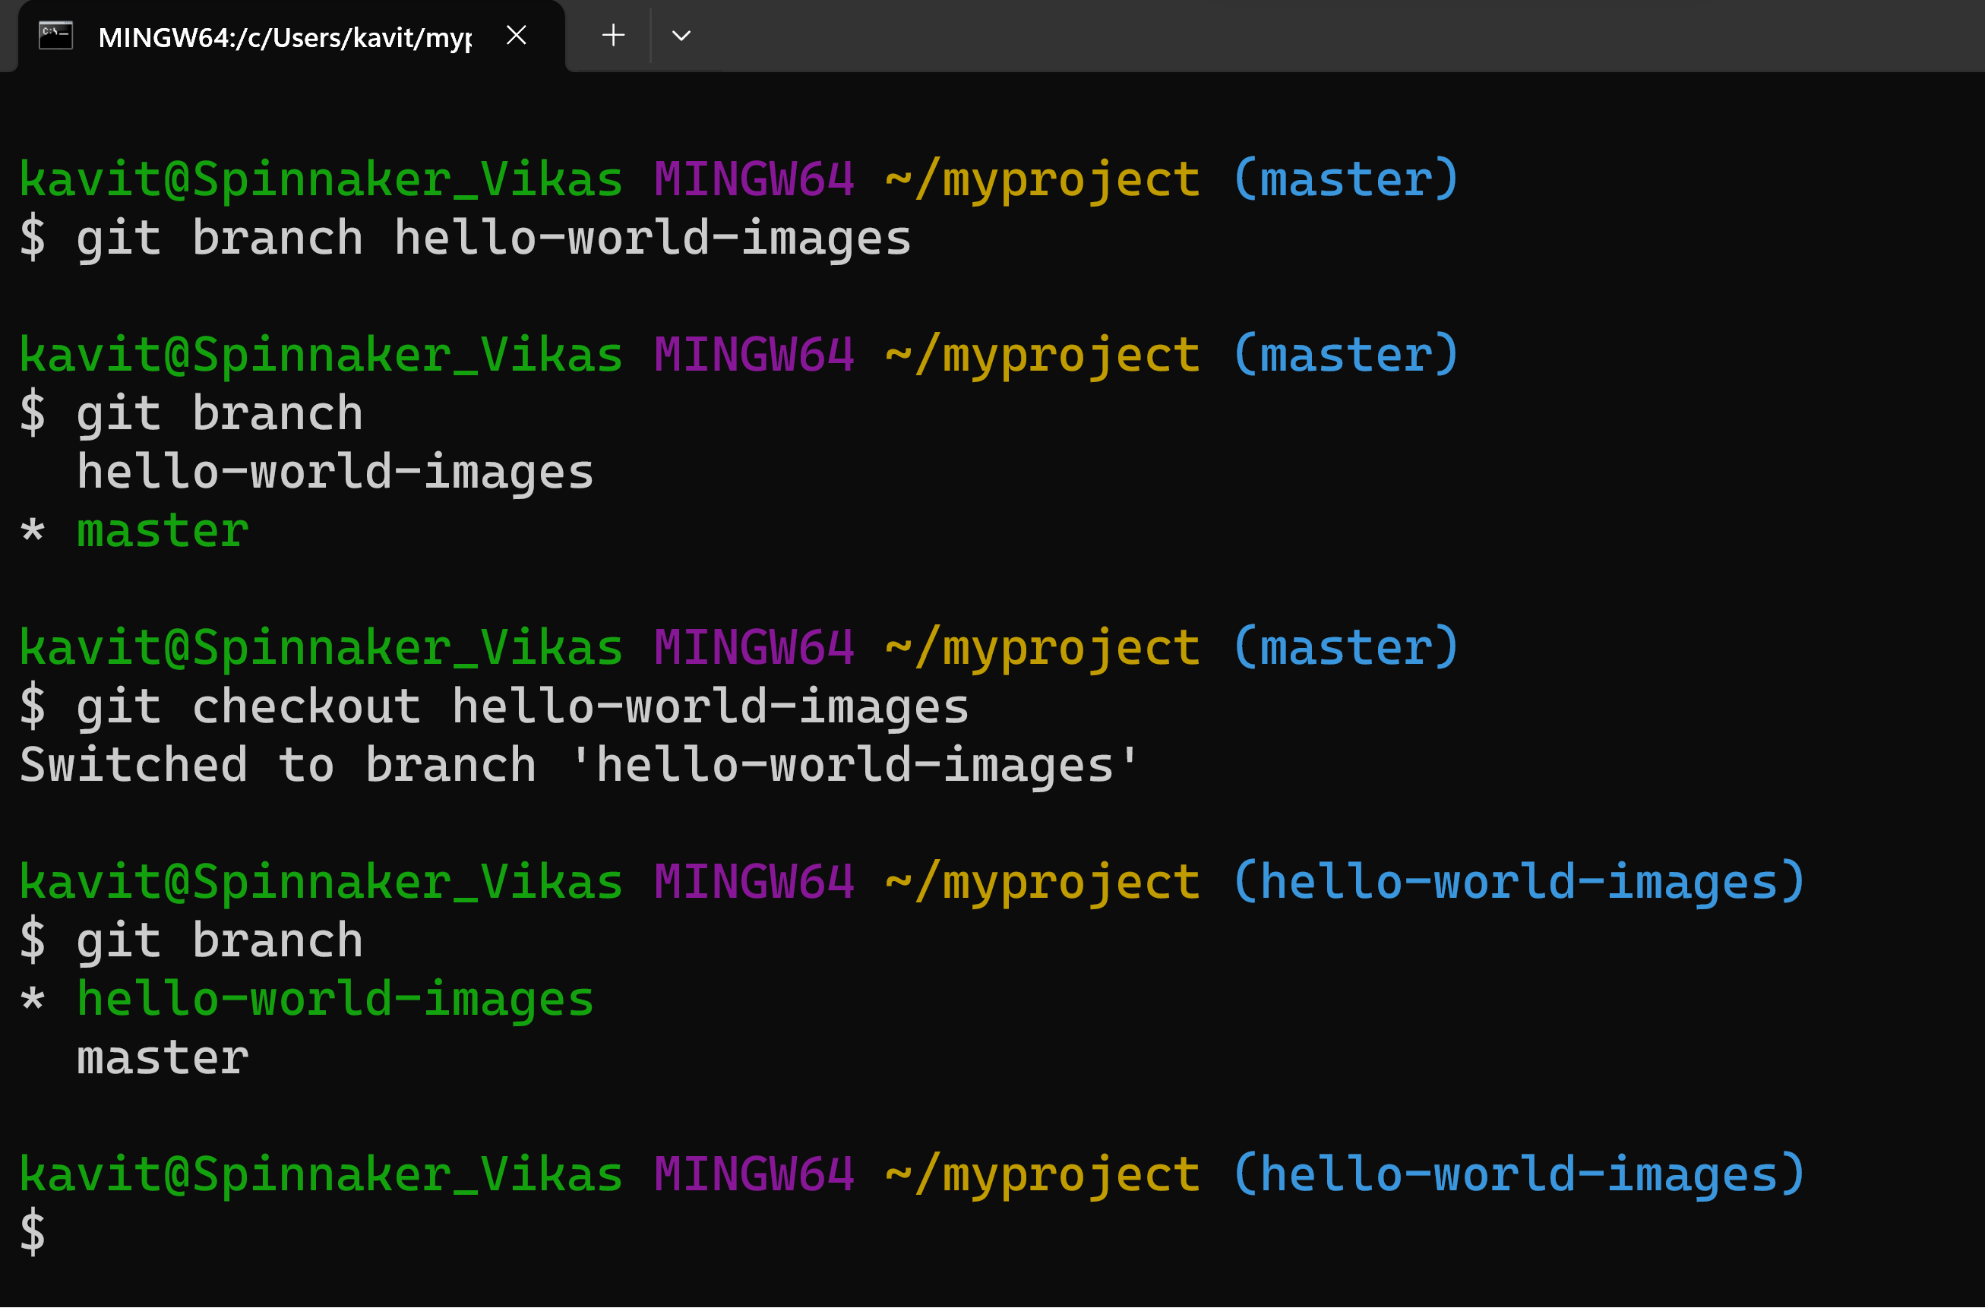
Git commands
Git Branch
In Git, a branch is a new/separate version of the main repository.
New Git Branch: Let add some new features to our index.html page.

Slide 39
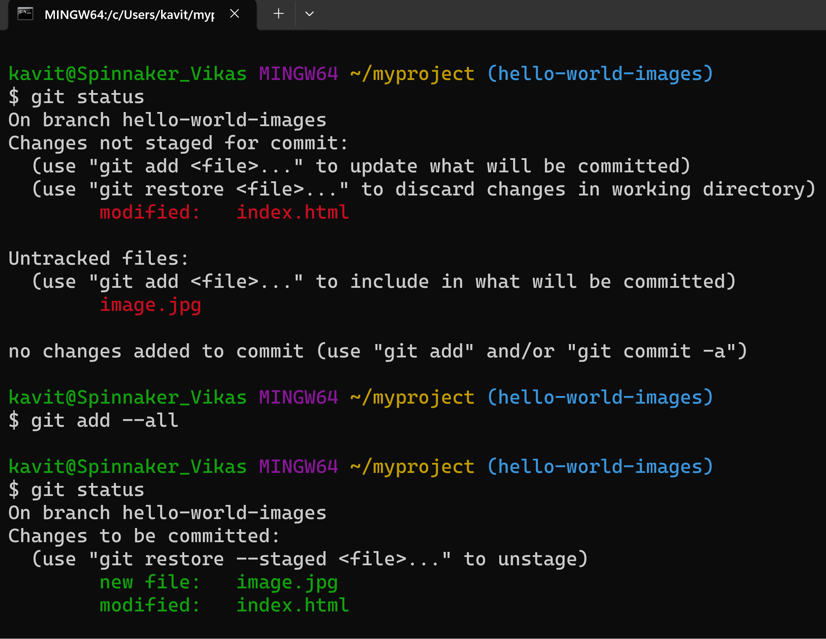
Git commands
There are changes to our index.html, but the file is not staged for commit
img_hello_world.jpg is not tracked
Using --all instead of individual filenames will Stage all changed
Check the status of the branch

Slide 40
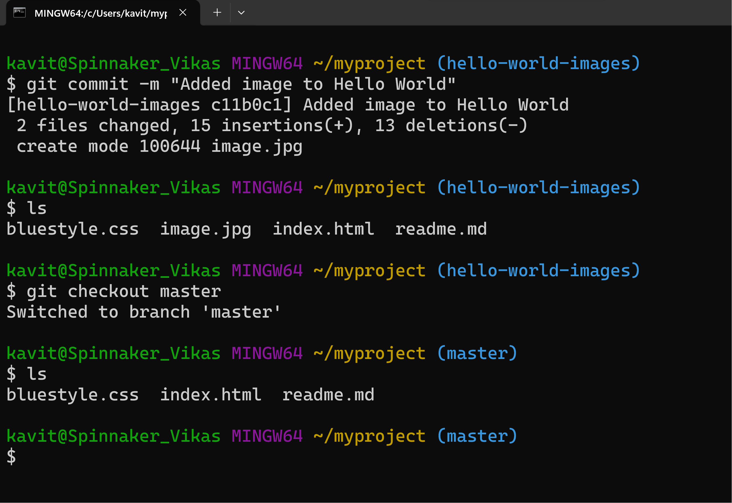
Git commands
Stage the file, and commit
we will commit them to the branch
we have a new branch, that is different from the master branch
checkout is the command used to check out a branch

Slide 41
Git commands
Stage the file, and commit
we will commit them to the branch
we have a new branch, that is different from the master branch
checkout is the command used to check out a branch

Slide 42
GitHub
Version Control: GitHub uses Git for tracking code changes.
Code Hosting: It's a platform to host and share your code repositories.
Collaboration: Facilitates collaborative software development and teamwork.
Issue Tracking: Helps manage project issues and milestones.
Pull Requests: Enables code review and collaboration.
Community: Fosters a developer community for open-source projects.
GitHub Pages: Hosts static websites for documentation and more.

Slide 43

GitHub
https://github.com/

Slide 44
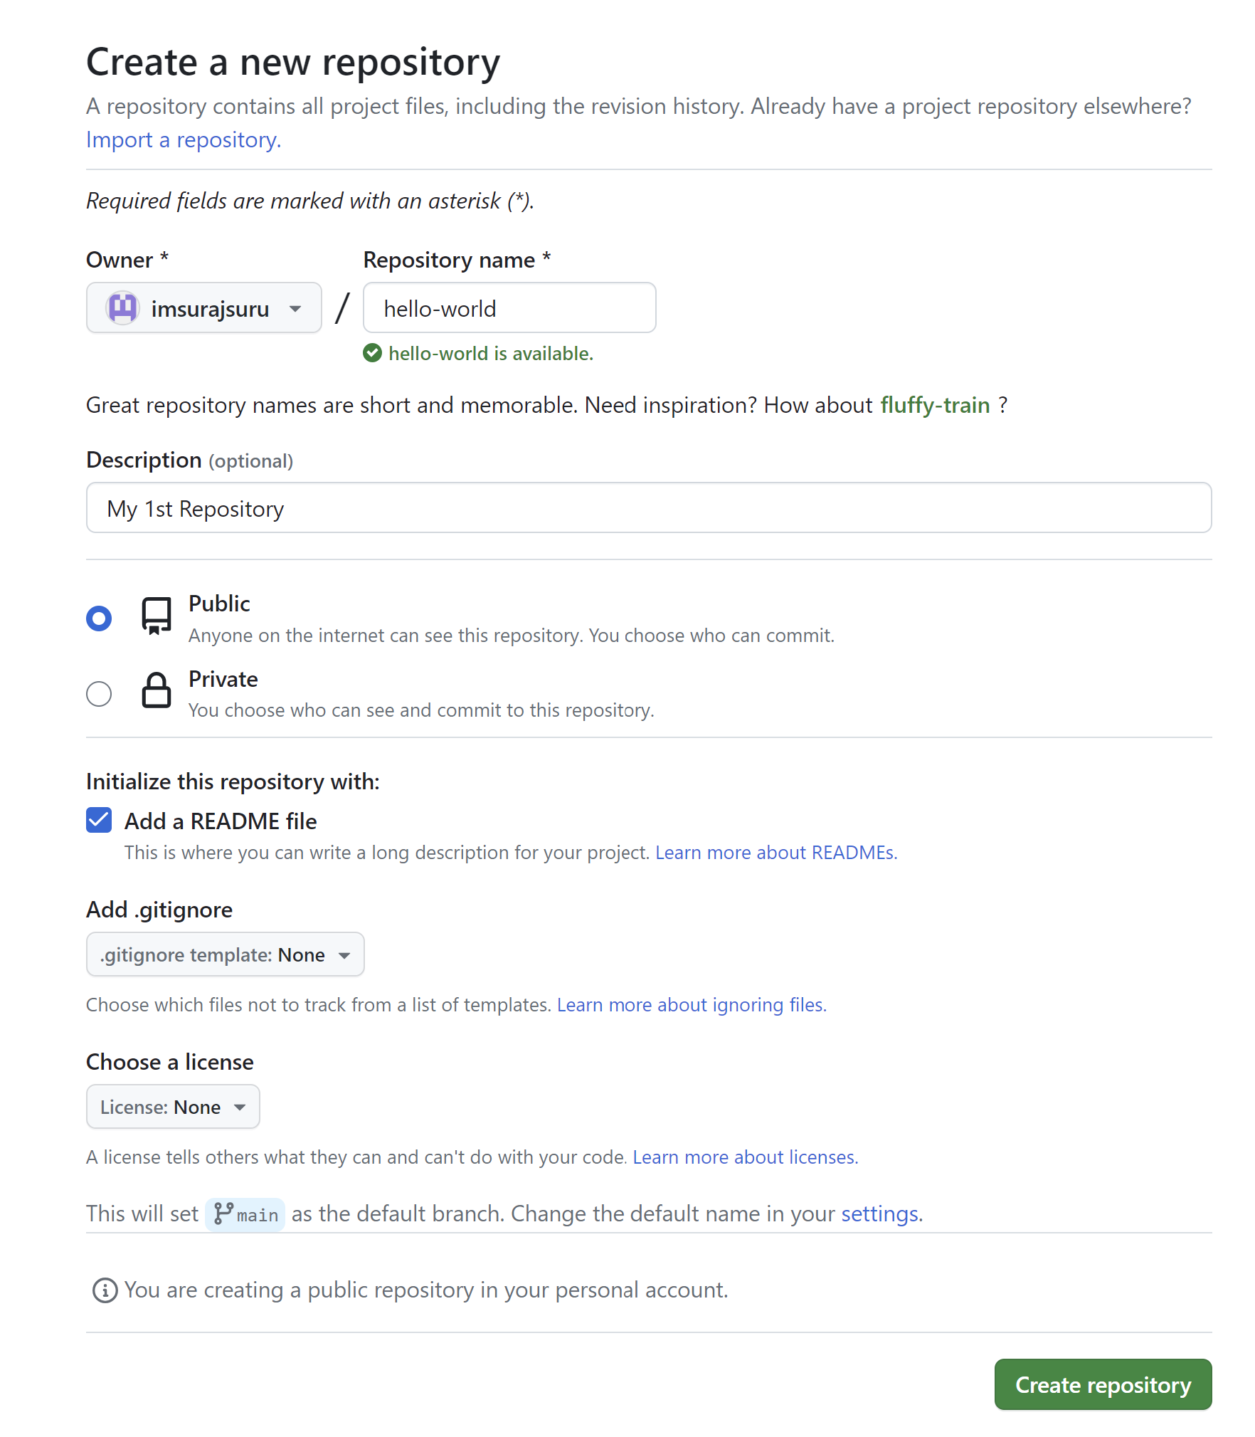
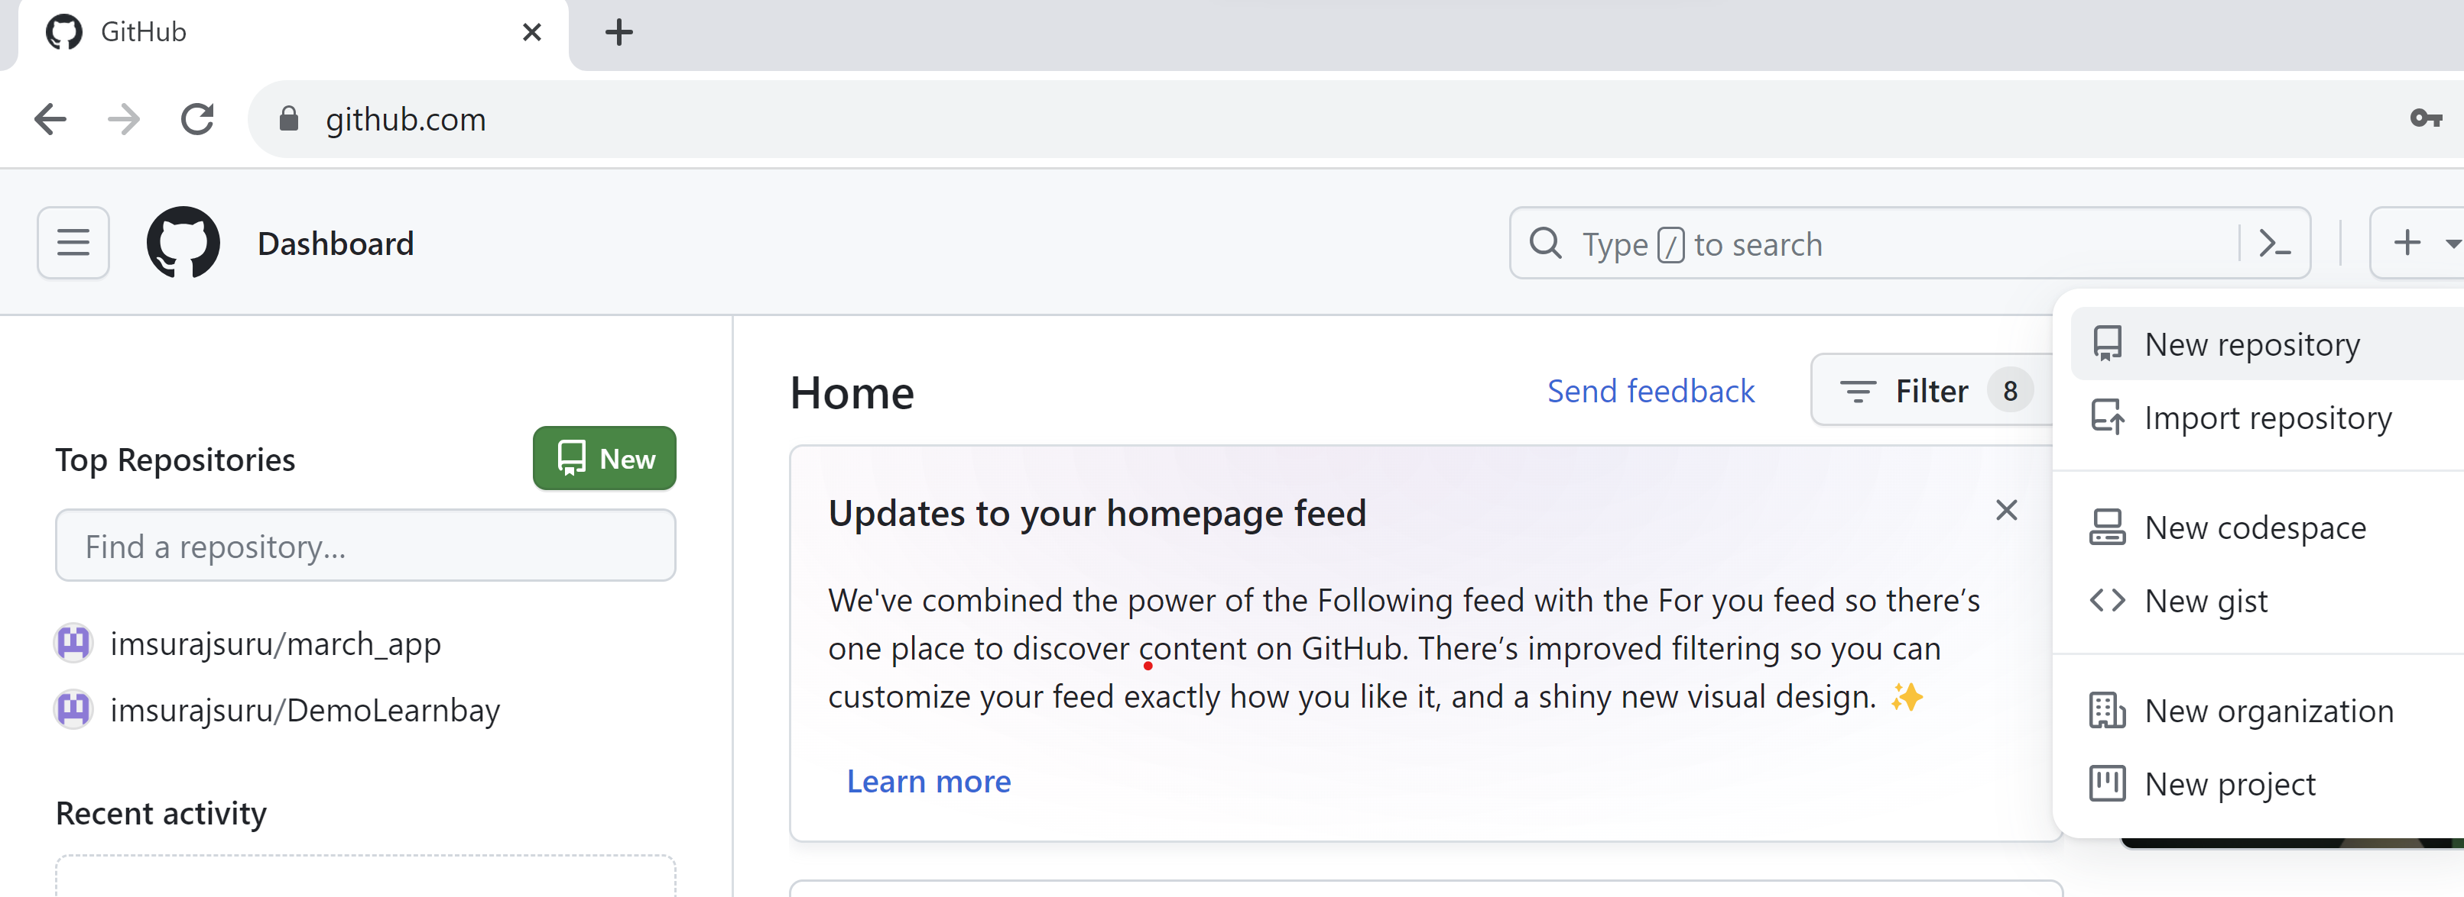
GitHub
Creating a Repository on GitHub

Slide 45
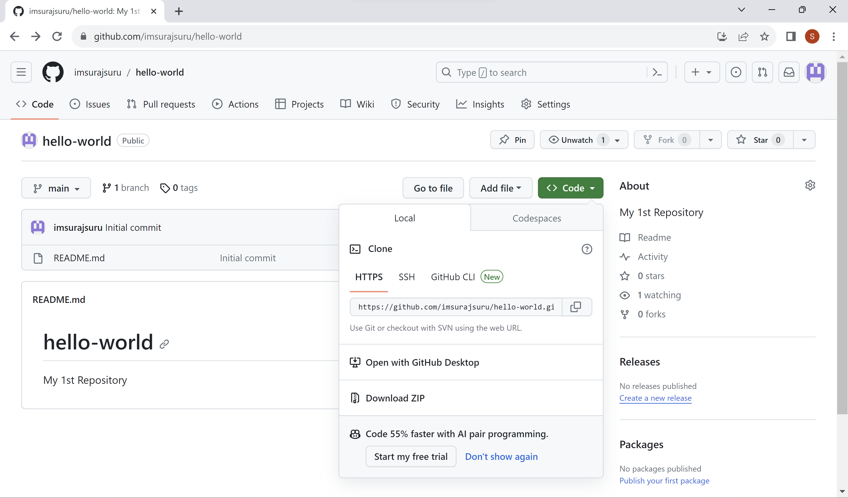
GitHub
Creating a Repository on GitHub

Slide 46
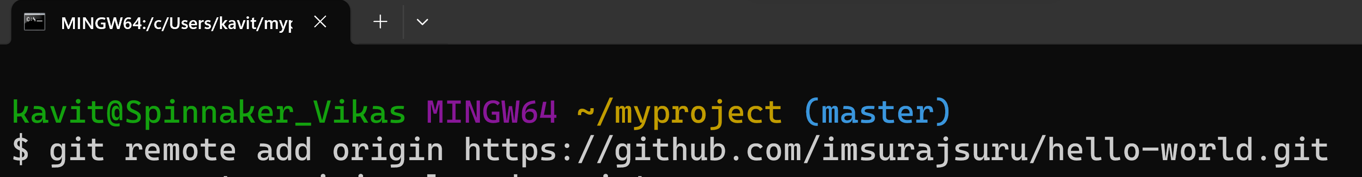
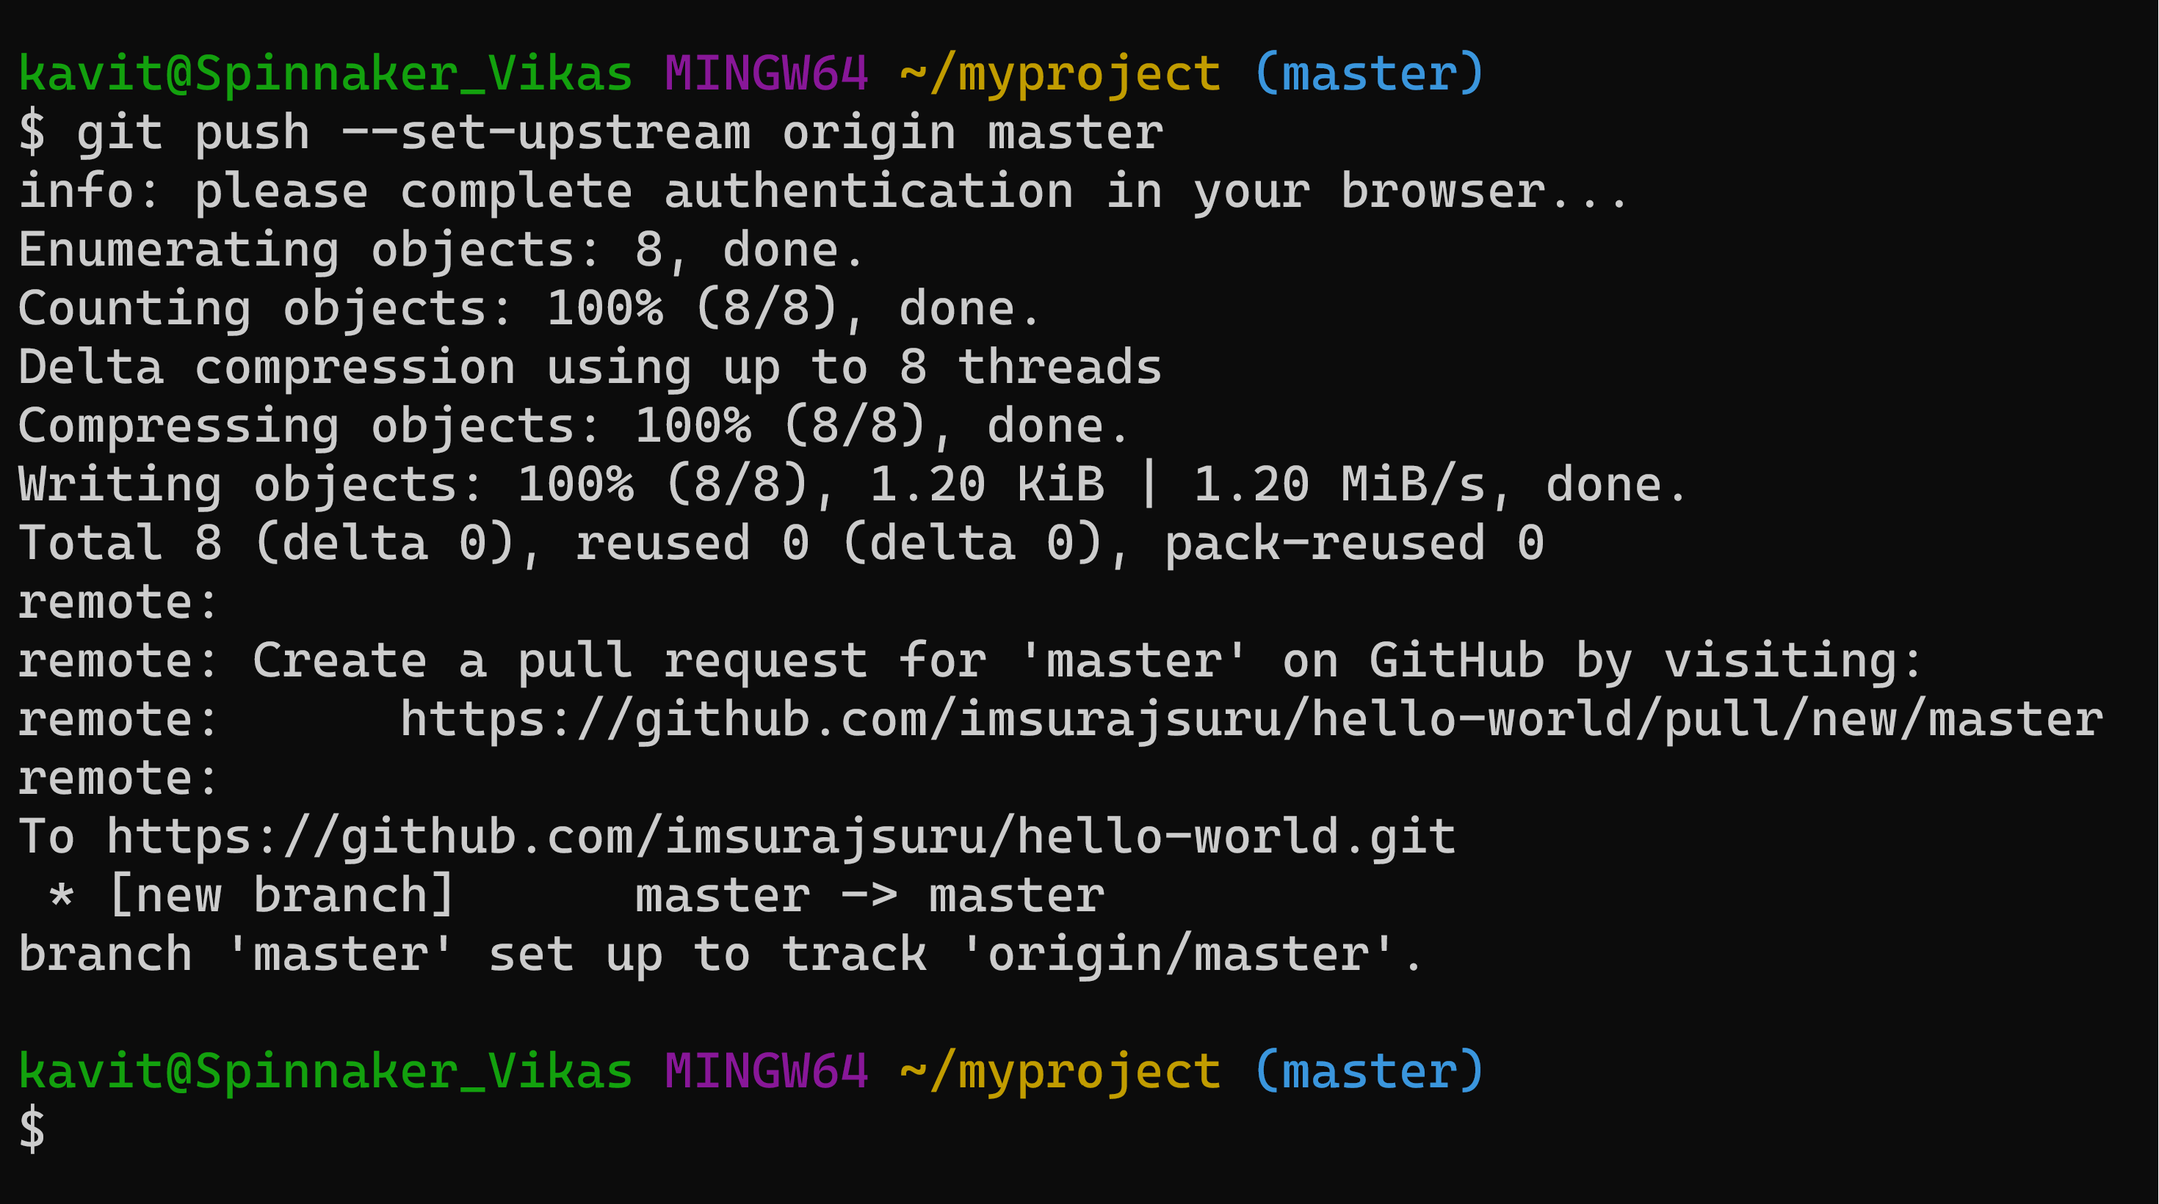
GitHub
Pushing Local Repository to GitHub

Slide 47
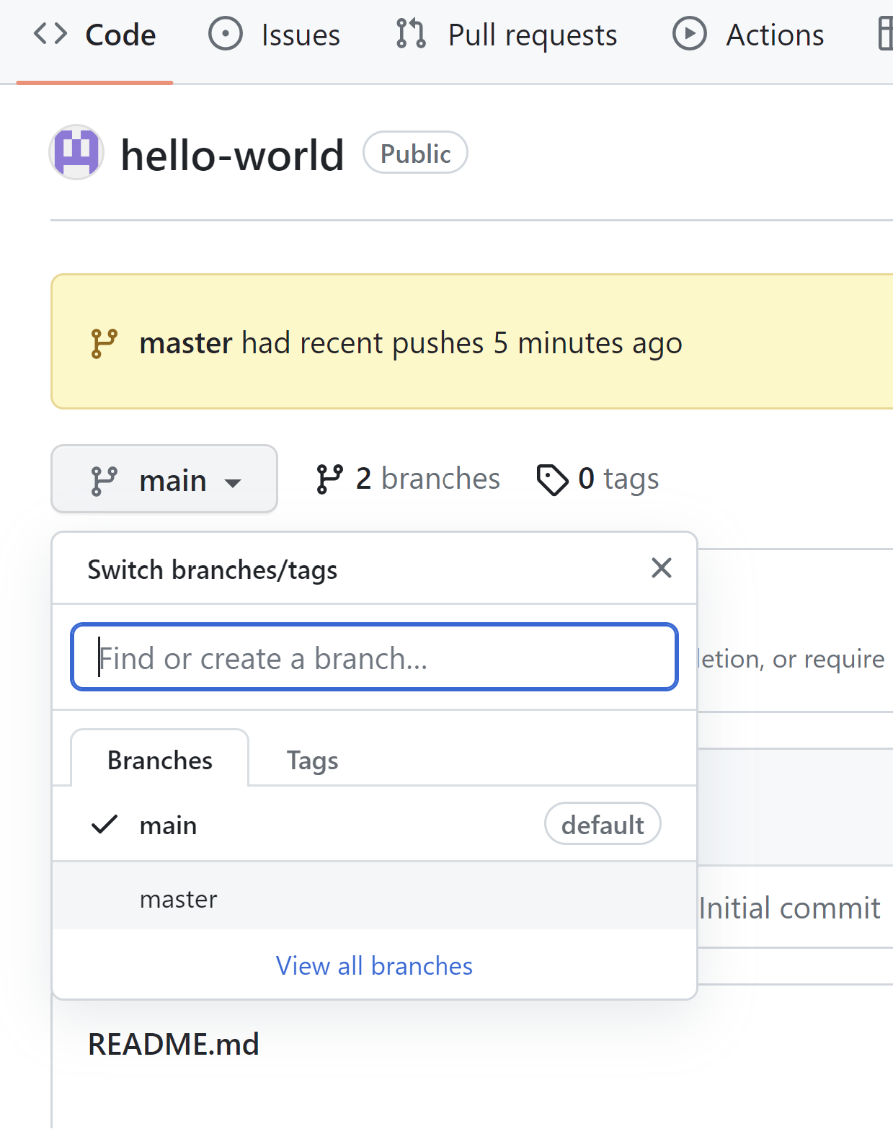
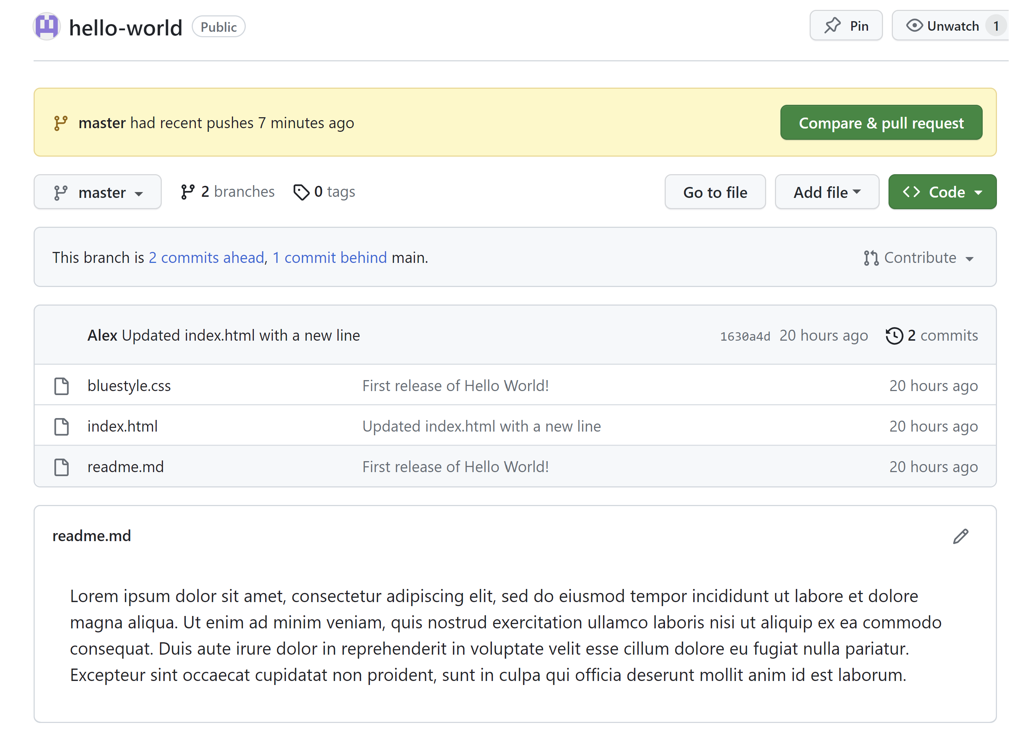
GitHub
Pushing Local Repository to GitHub

Slide 48
Thank You!!!

